Slide 1
Understand of Chromium OS
Alan Zhang

Slide 2
Background of Portage
The Chromium project started to use Portage build system.
Portage is a package management system used by Gentooto to install, uninstall and maintain software on your system from the source code.
The Portage system consists of:
Portage tree which is a collection of ebuilds, that is a local copy (located in /usr/portage/) of the central ebuild repository. Whenever you install software on your system with the emerge command, the Portage tree is searched. If a matching package name is found, its dependencies are calculated, the source code for the package and its dependencies are downloaded and then they're all compiled and installed onto your system.
Ebuild: a specialized BASH script to give a set of instructions to emerge as an interface to the Portage software management system. Each version of each application or package in the Portage repository has a specific ebuild script written for it.
Eclass: An eclass is a collection of code which can be used by more than one ebuild. three kinds of eclass:
Those which provide common functions which are used by many ebuilds (for example, eutils, versionator, cvs, bash-completion)
Those which provide a basic build system for many similar packages (for example, vim-plugin, kde)
Those which handle one or a small number of packages with complex build systems (for example, vim, toolchain, kernel-2)
emerge command: Executes the instructions in ebuilds (special scripts) in a sandbox environment;
The Portage configuration files;
The third-party Portage / emerge tools.

Slide 3
Ebuild syntax used in overlays
Variables
Column1 | Column2
EAPI | A version defined in ebuilds and other package manager related files which inform the package manager about the file syntax and content. It is, in effect, the version of the package manager specification (PMS) that the file adheres to.
S | The source directory for your package; commonly ${WORKDIR}/${P}. Portage will default to this value so you may not have to set it!
SLOT | Portage handles different versions of the same installed programs. If you would want, say GCC 2.95 and GCC 3.2 installed at the same time, you would specify the SLOT in each ebuild. Here we would set the SLOT of GCC 2.95 to 2 while we would set the SLOT of GCC 3.2 to 3. Note: Using 0 as the SLOT value signifies that this package only has 1 SLOT setting (in other words, this package is not SLOTable).
LICENSE | This variable specifies what license the program is covered under, i.e. GPL-2, BSD, etc... This field must be set to a valid license (which is any license found in /usr/portage/license/). If the license does not already exist there, it must be added before the ebuild can be added to the portage tree. If the license does not allow redistribution, make sure you placeRESTRICT="nomirror"intheebuild.
KEYWORDS | This variable now supports a couple of different functions. First of all, this variable specifies what architecture the ebuild is meant for. Some example keywords include: x86, ppc, sparc, mips, alpha, arm, hppa, amd64 and ia64. See the profiles/arch.list file in the Portage tree for more details. Obviously, you would set this to reflect the architecture of the target machine. Portage will not allow an x86 machine to build anything but x86, as specified by the KEYWORDS variable. Packages that do not support the native architecture are automatically masked by Portage. If the KEYWORDS flag has a preceding ~, then that indicates that the particular ebuild works, but needs to be tested in several environments before being moved to the stable profile with the given keyword. If the KEYWORDS flag has a preceding -,thenthepackagedoesnotworkwiththegivenkeyword.IfthereisnothingleadingKEYWORDS,thenthepackageisconsideredstable.YoucanallowinstallationofthesedifferenttypesofpackagesthroughtheACCEPT_KEYWORDSvariableinmake.conf.
DESCRIPTION | A short, one line description of your package.
IUSE | This is set to whatever USE variables your package utilizes. Remember that KEYWORDS should not be listed in here!
DEPEND | The package's build dependencies are listed here. See the section Package Dependencies for more details on proper syntax.
RDEPEND | The package's runtime dependencies are listed here. Once again, see Package Dependencies for more details.
Column1 | Column2
src_install | Use this function to install the package to an image in D. If your package uses automake, you can do this simply with emakeDESTDIR="${D}"install.MakesureyourpackageinstallsallitsfilesusingDastheroot!TheinitialworkingdirectoryisS.

Slide 4
Key elements and Concepts in Portage
Gentoo Portage tree does not contain directories of Makefiles, but of so-called ebuilds, bash scripts that describe separate functions to download, configure, make, install and remove a package and additional functions that can be used to set up the operating environment for a package.
ebuilds are shell scripts with variables and functions which contain a description of the software, and instructions on how to obtain, configure, compile, and install it, more closely akin to (but more powerful than) the .spec files distributed in SRPMs.
Portage's main utility is emerge, which is written in Python. emerge provides an interface to ebuild : managing an ebuild repository, resolving dependencies and similar issues.
The Portage system offers the use of "USE flags," which allows users to indicate which software features they would like to include (and exclude) while building packages.

Slide 5
depot_tools
Chromium uses a package of scripts, the depot_tools, to manage interaction with the Chromium source code repository and the Chromium development process. It contains the following utilities:
gclient: Meta-checkout tool managing both subversion and git checkouts. It is similar to repo tool except that it works on Linux, OS X, and Windows and supports both svn and git. On the other hand, gclient doesn't integrate any code review functionality.
gcl: Rietveld code review tool for subversion. The gcl tool runs presubmit scripts.
git-cl: Rietveld code review tool for git. The git-cl tool runs presubmit scripts.
hammer: (Obsolete) Wrapper script for building Chromium with the SCons software construction tool.
svn [Windows only]: subversion client for Chromium development. (Executable Subversion binaries are included in the depot_tools on Windows systems as a convenience, so that working with Chromium source code does not require a separate Subversion download.)
drover: Quickly revert svn commits.
cpplint.py: Checks for C++ style compliance.
presubmit_support.py: Runs PRESUBMIT.py presubmit checks.
repo: The repo tool.
trychange.py: Try server tool. It is wrapped by gcl try and git-try.
git-try: Try change tool for git users
wtf: Displays the active git branches in a chromium os checkout.
weekly: Displays the log of checkins for a particular developer since a particular date for git checkouts.
git-gs: Wrapper for git grep with relevant source types.
zsh-goodies: Completion for zsh users.
Notes:
http://dev.chromium.org/developers/how-tos/depottools

Slide 6
Ninja
Ninja is yet another build system. It takes as input the interdependencies of files (typically source code and output executables) and orchestrates building them, quickly.

Slide 7
cros_workon
cros_workon is a workflow tool for ChromiumOS development. With cros_workon, developers subscribe to the packages they want to work on. The tools then only checkout the packages a developer is subscribed to and only builds the packages a developer is subscribed to.
When using cros_workon, two new commands are used instead:
repo: Usually run outside the chroot.
It's used to check out and sync your repositories and manage the tracking branches for git.
src/scrips/cros_workon: Always run inside the chroot.
It's used to unmask a package ebuild so that
1) repo will be prepared to sync a local copy of the source, and
2) build_packages will use the local source instead of the stable version.

Slide 8
Build Chromium OS
$repo init -u http://git.chromium.org/git/manifest -m minilayout.xml
$repo sync
$cd src/scripts
$./make_chroot
To simplify dependencies, development is done inside a chroot.
$./enter_chroot.sh
To enter the chroot in order to do development.
Or ./enter_chroot.sh --chrome_root=$(PATH/TO/CHROMIUM-BROWSER/SRC)
$ ./setup_board --board=x86-generic –default --job 4
Run setup_board in order to install the toolchain (gcc/glibc) for the target you wish to work on. setup_board also creates the initial SYSROOT the target.
$./enable_localaccount.sh USERNAME
The local user account allows login with no password even if you can not connect to the Internet.
$./set_shared_user_password.sh
Need to set up the password for the shared user. The encrypted password will be stored in ./shared_user_password.txt.
$ ./build_packages --board="x86-generic" --jobs=4
By default, build_packages will build the stable version of a package (i.e. from committed git sources) unless you are working on a package. If you are working on a package, build_packages will build using your local sources.
$ ./build_image --noenable_rootfs_verification

Slide 9
Examples of Use Cases
Flash bootable and installation Chromium OS Built Image
$./image_to_usb.sh --from=../build/images/x86/Version.BuiltDate&Time --to=/dev/USB-Node
“USB-Node” should be like “/dev/sdc” other than “/dev/sdc1”
Start working on specific package
$./cros_workon --board=${BOARD} start ${PACKAGE_NAME} : This marks the ebuild for the given package so that build_packages will use your local changes instead of the stable, committed version.
$ ./cros_workon --board=${BOARD} list --all : Check all the available packages; Special case : chromiumos-overlay is not in this list and cros_workon start/stop is not used.
Stop working on specific package
$ ./cros_workon --board=${BOARD} stop ${PACKAGE_NAME} : This tells the buildsystem to use stable pre-built version of the package. build_packages will now ignore your local repository. Stopping doesn't delete your local copy.
Autotest
$ ./cros_workon start autotest autotest-tests
$ repo sync
Tests consist of a build phase and run phase, where the first is executed by the ebuild, and the second by the run_remote_tests.sh" script. tests have to be built with emerge-${board} before they can be ran using run_remote_tests.sh.
Currently, tests are organized within these ebuilds : chromeos-base/autotest-tests
To see which tests are implemented by an ebuild, run the usual pretended emerge:
$ emerge-${board} -pv autotest-tests
All tests have a default state, either enabled (+) or disabled (-). The TESTS= variable is a USE_EXPAND.
There are two ways to use these.
(1) Non-Incremental --- Simply override the list by a new list
TESTS="platform_MiniJailPidNamespace platform_MiniJailPtraceDisabled" emerge-${board} -pv autotest-tests
(2) Incremental --- All USE_EXPAND flags are also accessible as USE flags, with the appropriate prefix, and can be used incrementally with +, -
USE="tests_platform_MiniJailPidNamespace tests_platform_MiniJailPtraceDisabled" emerge-${board} -pv autotest-tests
Notes:
https://www.chromium.org/chromium-os/developer-guide/developer-workflow
https://sites.google.com/a/chromium.org/dev/chromium-os/chromiumos-design-docs

Slide 10
Chrome Web Apps
Apps
hosted app
packaged app
Themes
Extensions
Remote Desktop Capabilities - Chromoting
GPU Accelerated Compositing – WebGL
WebGL is a cross-platform, royalty-free API used to create 3D graphics in a Web browser. Based on OpenGL ES 2.0, WebGL uses the OpenGL shading language, GLSL, and offers the familiarity of the standard OpenGL API.
Chromium must be launched from the command line in order to enable WebGL.
Linux : ./chrome --enable-webgl
Mac OS X : ./Chromium.app/Contents/MacOS/Chromium --enable-webgl
Windows : No command line options needed.

Slide 11
Firmware
Functionalities
System recovery
Verified boot
Fast boot

Slide 12
淺談 Malicious Engine https://v2bv.net/2017/intel-me
什麼是 ME？
Intel ME 是 Intel Management Engine 的簡稱。
Intel ME 是一個擁有從底層控制硬件能力的、獨立與處理器和操作系統的框架，它對於操作系統也是隱形的。簡單點說就是擁有極高的權限。其中 Intel Active Management Technology（英特爾主動管理技術）是運行與 ME 框架上的應用的一個例子。
Intel ME 被搭載在幾乎所有的 2006 年之後上市出售的 intel 平臺上。硬件部分整合在 CPU 或是主板芯片組內；軟件（固件）部分一般與 BIOS 共存在一個 ROM 芯片中（如果把 ROM 的內容提取出來的話，會發現 ME 固件往往比 BIOS 本身以及 GBE 固件加在一起還大）。
在 Linux 平臺上可以使用 intelmetool 來查看 ME 的狀態。
Notes:
Reference :
For ME firmware: https://v2bv.net/2017/intel-me

Slide 13
使用coreboot (1/6) https://v2bv.net/2018/coreboot
編譯 coreboot 的依賴裝好,gcc,gnat,bison,flex,ncurses,wget,zlib
coreboot 的源碼拖下來:
$ git clone https://review.coreboot.org/coreboot.git
$ cd coreboot && git submodule update --init --checkout
$ git clone https://review.coreboot.org/flashrom.git
進入 coreboot 的源碼目錄裏，準備好工具鏈等等：
$ make crossgcc-i386 CPUS=4 # 這裏只需要給 X220 用，所以準備 i386 的工具鏈就足夠了
$ make iasl # 準備 iASL 編譯器
用 flashrom 把現有的固件 Dump 出來：
$ sudo flashrom -p internal:laptop=force_I_want_a_brick -c MX25L6405D -r dump.rom # 這裏舉例用的是 internal flash 的命令，如果用編程器的話需要根據編程器進行修改。
進入 coreboot 源碼目錄的 util/ifdtool 目錄下並編譯它：
$ cd util/ifdtool && make
使用 ifdtool 解鎖固件描述（firmware descriptor）和 ME 區域。
$ ifdtool -u dump.rom # 把文件名改成自己的, ifdtool 會創建一個新的 dump.rom.new，接下來的步驟要用它。
想幹掉 ME 的話現在拿去過一邊 me_cleaner 應該就可以刷回去了。
$ me_claner.py dump.rom.new # 換成你自己的文件名
進入 flashrom 源碼目錄下的 util/ich_descriptors_tool 目錄並編譯 ich_descriptors_tool
$ cd util/ich_descriptors_tool && make

Slide 14
使用coreboot (2/6) https://v2bv.net/2018/coreboot
然後用它來提取文件：
$ ich_descriptors_tool -f dump.rom.new -d # 當然，還是要改成自己的文件名. 這個工具會輸出一大堆東西，我們只要它創建的 dump.rom.new.Descriptor.bin、dump.rom.new.ME.bin 和 dump.rom.new.GBE.bin,分別代表着需要用到的三大坨 blob。
然後我們可以把這些文件複製到 coreboot 源碼目錄的 3rdparty/blobs 目錄的對應位置裏（這是爲了之後配置起來方便點）。
$ cp dump.rom.new.Descriptor.bin ~/coreboot/3rdparty/blobs/mainboard/lenovo/x220/descriptor.bin
$ cp dump.rom.new.ME.bin ~/coreboot/3rdparty/blobs/mainboard/lenovo/x220/me.bin
$ cp dump.rom.new.GBE.bin ~/coreboot/3rdparty/blobs/mainboard/lenovo/x220/gbe.bin

Slide 15
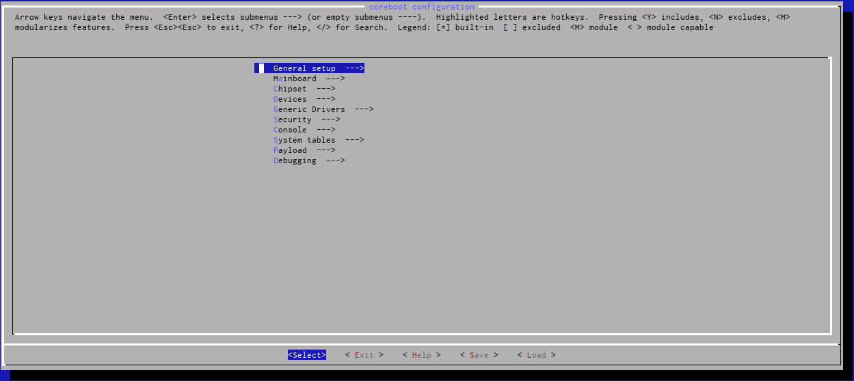
使用coreboot (3/6) https://v2bv.net/2018/coreboot
接下來就是配置 coreboot, 回到 coreboot 的源碼目錄下執行 make menuconfig 開始配置。
進入第一個 General setup，
[*] Generate flashmap descriptor parser using flex and bison
[*] Generate SCONFIG & BLOBTOOL parser using flex and bison
[*] Use CMOS for configuration values
[*] Compress ramstage with LZMA
[*] Include the coreboot .config file into the ROM image
[*] Create a table of timestamps collected during boot
[*] Allow use of binary-only repository # 這條一定要打開
-*- Build the ramstage to be relocatable in 32-bit address space.

Slide 16
使用coreboot (4/6) https://v2bv.net/2018/coreboot
之後是 Mainboard，
*** Important: Run 'make distclean' before switching boards ***
Mainboard vendor (Lenovo) ---> # 選聯想
Mainboard model (ThinkPad X220) ---> # 當然是 X220 啦
ROM chip size (8192 KB (8 MB)) ---> # 除非你魔改過，不然不用改
(0x100000) Size of CBFS filesystem in ROM
() fmap description file in fmd format
然後 Chipset：
[*] Enable VMX for virtualization
[*] Set lock bit after configuring VMX
-*- Use native raminit
[*] Beep on fatal error
[*] Flash LEDs on fatal error
[*] Support bluetooth on wifi cards
*** Intel Firmware ***
[*] Add Intel descriptor.bin file # 必選
[*] Add Intel ME/TXE firmware # 必選
(3rdparty/blobs/mainboard/$(MAINBOARDDIR)/me.bin) Path to management engine firmware # 同上
[*] Verify the integrity of the supplied ME/TXE firmware
[*] Strip down the Intel ME/TXE firmware # 如果要幹 ME 的話選上這個
*** Please test the modified ME/TXE firmware and coreboot in two steps ***
[*] Add gigabit ethernet firmware # 必選

Slide 17
使用coreboot (5/6) https://v2bv.net/2018/coreboot
Devices 裏：
-*- Enable PCIe Common Clock
-*- Enable PCIe ASPM
[*] Enable PCIe Clock Power Management
[*] Enable PCIe ASPM L1 SubState
[*] Enable I2C controller emulation in software
Generic Drivers 裏基本不需要動:
[*] SPI flash driver support in SMM
[*] Support Intel PCI-e WiFi adapters
[*] PS/2 keyboard init # 必選
[*] Enable TPM support # 如果需要 TPM 的話可以選上
Security 下沒需求的話就不用改了：
Verified Boot (vboot) --->
[ ] Verify firmware with vboot.
Console 裏：
[*] Squelch AP CPUs from early console.
[*] Send POST codes to an IO port
System Table：
[*] Generate SMBIOS tables
Payload 裏比較特殊，需要根據自己的需求選擇 _(:з」∠)_。現在官方支持的 Payload 有：
None - 無，什麼都沒有。
An ELF executable payload - 一個 ELF 可執行文件作爲 Payload。
Bayou - 一個可以從 CBFS（coreboot filesystem）裏選擇並啓動別的 payload 的工具（是不是有點繞）。
FILO - 一個啓動管理器，比較簡單的那種。
GRUB2 - 知名啓動管理器。
SeaBIOS - 一個開源的 BIOS 實現，爲默認選項。
U-Boot - 熟悉 ARM 的朋友應該知道（跑A Linux payload - 直接把一個 Linux 內核作爲 payload 塞進去。
Tianocore coreboot payload package - 開源的 UEFI 實現。

Slide 18
使用coreboot (6/6) https://v2bv.net/2018/coreboot
全部配置好之後保存然後退出。使用 make,編譯好的固件在源碼目錄的 build/coreboot.rom。
進入 build 目錄下就可以用 flashrom 刷了。
$ sudo flashrom -p internal:laptop=force_I_want_a_brick -c MX25L6405D -w coreboot.rom # 同樣的，這裏的命令也是 internal flash 的命令，如果用編程器的話需要根據情況進行修改。
如何配置 GRUB2
GRUB2 需要一個配置文件才能正常工作，詳細情況可以參考 https://github.com/hardenedlinux/Debian-GNU-Linux-Profiles/blob/master/docs/hardened_boot/grub-for-coreboot.md
幾個注意點：
一些經常變動的東西可以寫到硬盤上讓 GRUB 自己去加載，而不是寫到固件裏面。
(memdisk) 和 (cbfsdisk) 要區分清楚，(cbfsdisk) 是 ROM 裏的 CBFS 區域，而 (memdisk) 是 grub-mkstandalone 時包括進去的部分。
如果圖形相關選擇的是 native init 的 high-resolution framebuffer，並且進去後發現只有四分之一個屏幕可用的話可以試着在配置裏加上 gfxpayload=keep 和 terminal_output --append gfxterm，應該可以讓它恢復正常。
Notes:
Assemble GRUB executable for coreboot: https://github.com/hardenedlinux/Debian-GNU-Linux-Profiles/blob/master/docs/hardened_boot/grub-for-coreboot.md

Slide 19
Build Firmware of Coreboot, and EC for Carol
Sync coreboot code
export REPO_HOST_PORT_INFO="chromium.XXXXXXX.com 418"
mkdir ~/workspace/ldev-consolidated_01
cd ~/workspace/ldev-consolidated_01
repo init -u ssh://chromium.XXXXXXX.com/chromiumos/manifest-mirror.git
repo sync
Build coreboot with Intel FSP
cros_sdk --enter
./setup_board --board=carol
cros_workon-carol start coreboot depthcharge libpayload vboot_reference chromeos-bootimage chromeos-mrc
# FSP build
USE="fsp_src" emerge-carol sys-boot/chromeos-mrc
# Coreboot build
emerge-carol coreboot coreboot-private-files-carol depthcharge libpayload vboot_reference chromeos-bootimage
NOTE: There can be build errors if the error is because of the missing file "ec.RW.bin"
sudo touch /build/carol/firmware/ec.RW.bin; sudo touch /build/carol/firmware/ec.RW.bin, and re-run the emerge step.
your output image is /build/carol/firmware/image.*.bin. Flashing the image.bin under /build/carol/firmware directory on to SPI via dediprog.
Build EC Firmware
cros_workon-carol start chromeos-ec
emerge-carol chromeos-ec

Slide 20
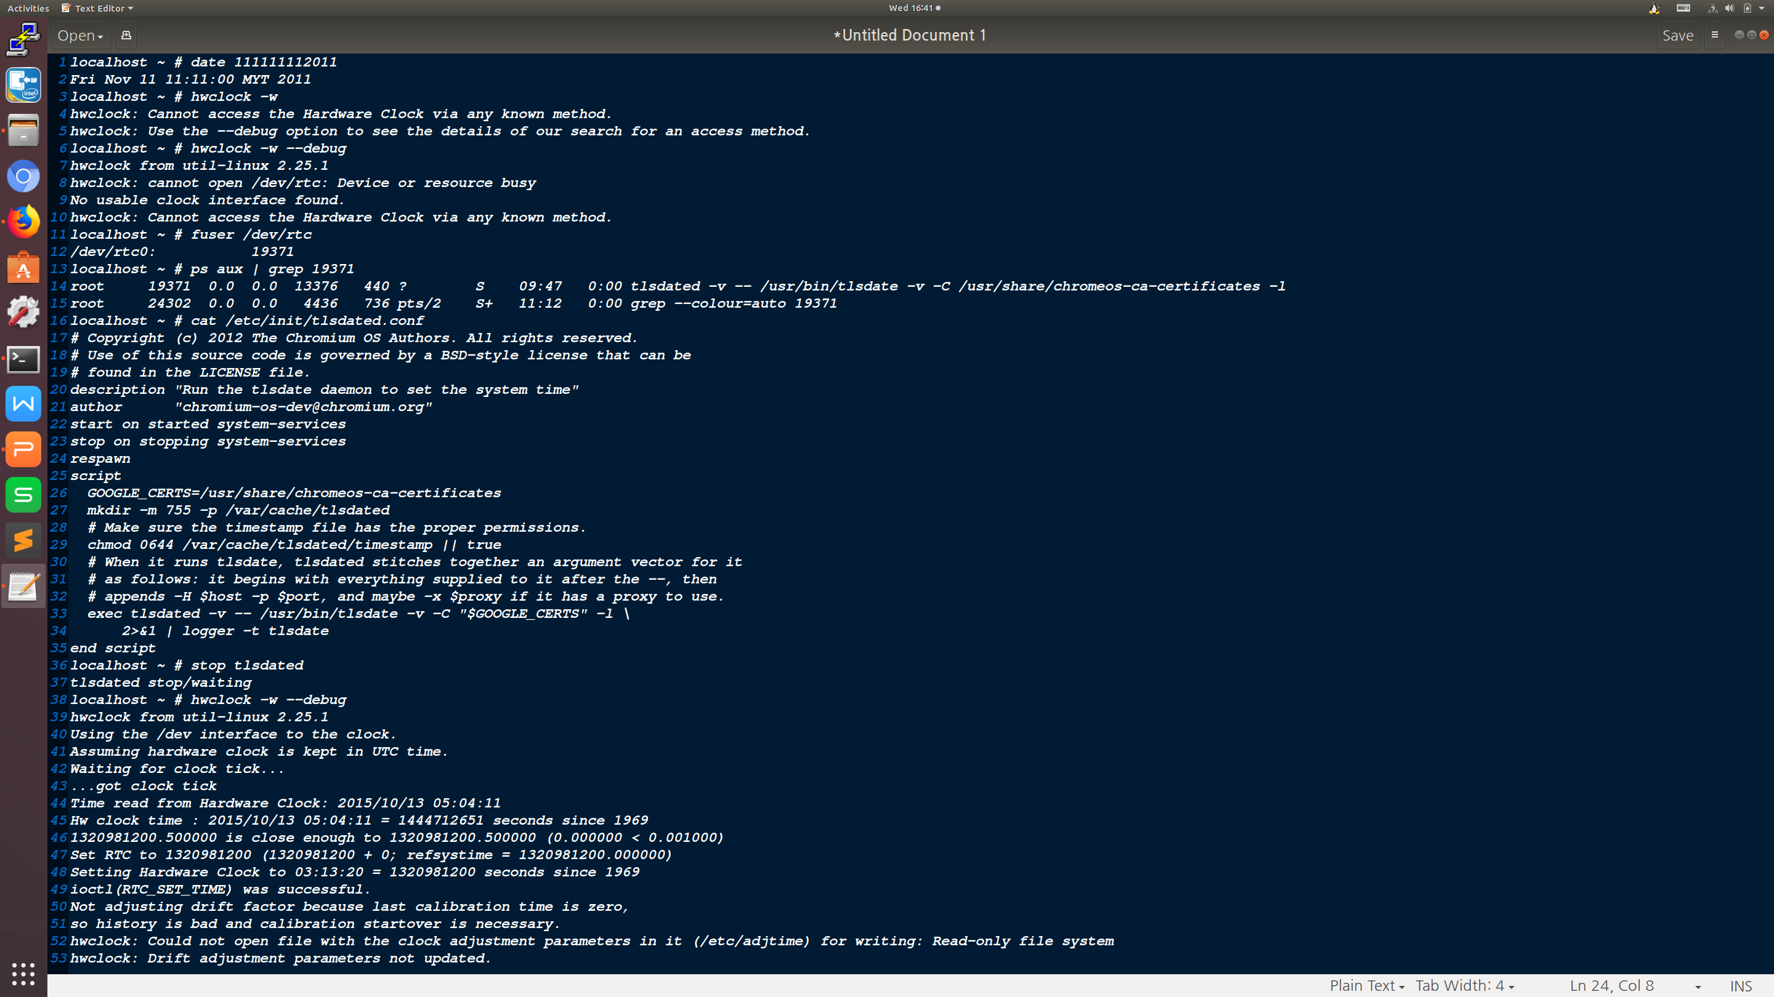
How to Change Date Time inside Chromium OS

Slide 21
How to share files for inside and outside chroot
The cros_sdk command supports mounting additional directories into your chroot environment. This can be used to share editor configurations, a directory full of recovery images, etc.
You can create a src/scripts/.local_mounts file listing all the directories (outside of the chroot) that you'd like to access inside the chroot. For example:
# source(path outside chroot) destination(path inside chroot)
/usr/share/vim/google
/home/YOURID/Downloads /Downloads
Each line of .local_mounts refers to a directory you'd like to mount, and where you'd like it mounted. For security and safety reasons, all directories mounted via .local_mounts will be read-only.
Reference: http://dev.chromium.org/chromium-os/tips-and-tricks-for-chromium-os-developers

Slide 22
General Development Tasks on Chromium OS
Repo chromium os codebase
Install depot_tools and repo sync init and sync chromium codebase
cros_sdk # Bring you to the chroot environment
(cr) $ export BOARD=your_platform_name
(cr) $ ./setup_board --board=your_platform_name --nousepkg
(cr) $ ./build_packages --board=your_platform_name --nousepkg
(cr) $ ./build_image --board=your_platform_name --noenable_rootfs_verification test --boot_args='earlyprintk=serial,ttyS0,115200 console=ttyS0,115200 loglevel=8'
Updating your device using USB
(cr) $ ./image_to_usb.sh --board=your_platform_name --to=/dev/sdd --from=../build/images/your_platform_name/Chromium...
Or: (cr) $ cros flash usb:// /path/to/*image.bin
Boot from USB
Option 1: On the device, goto recovery mode by pressing Esc + Refresh (aka the third function key from left) + Power and then insert your USB drive
Option 2: While booting up, if you are in developer mode, it displays a screen with red text that you are in developer mode and press Ctrl+U to boot from USB. Press Ctrl+U
Enter dev shell
Option 1: After booting completes, press Ctrl + Alt + F2 to go to the dev shell (Note, this was broken in some releases)
Option 2: Login as guest if you have not set up any account yet, else login with your account. Launch browser, press Ctrl+Alt + T, you get a chrome shell. Type shell to get a dev shell
Login with chronos or root and run the following command. (If built in test mode, as of now the pwd is test0000.)
$ sudo chromeos-install --dst /dev/mmcblk0

Slide 23
How to add private overlay for specific platform (1/2)
Assumption: chromium-os source pool, here is a short note to build image for your_platform_name
$ cd .repo
$ mkdir -p local_manifests
$ cd local_manifests
$ vim local_manifest.xml # includes the following lines:
<?xml version='1.0' encoding='UTF-8'?>
<manifest>
<remote name="Alias Name of My Remote Server" fetch="URL of this remote server. ex. https://chromium.xxxx.com" review="URL of this remote server. ex. https://chromium.xxxx.com"/>
<project name="chromeos/overlays/overlay-your_platform_name-private" path="src/private-overlays/overlay-your_platform_name-private" remote="Alias Name of My Remote Server"/>
</manifest>
Back to ToT, "cd ../..; repo sync"
Build packages and images # Refer to page 21
Examine built images
(cr) $ ./mount_gpt_image.sh --board=${BOARD} -f $(./get_latest_image.sh --board=${BOARD})
(cr) $ # Do something you'd like to check
(cr) $ ./mount_gpt_image.sh --board=${BOARD} -u # remember to umount
Note: If you built test image (./build_image.sh .... test ), do not use get_latest_image.sh script, append the path of chromiumos_test_image.bin directly

Slide 24
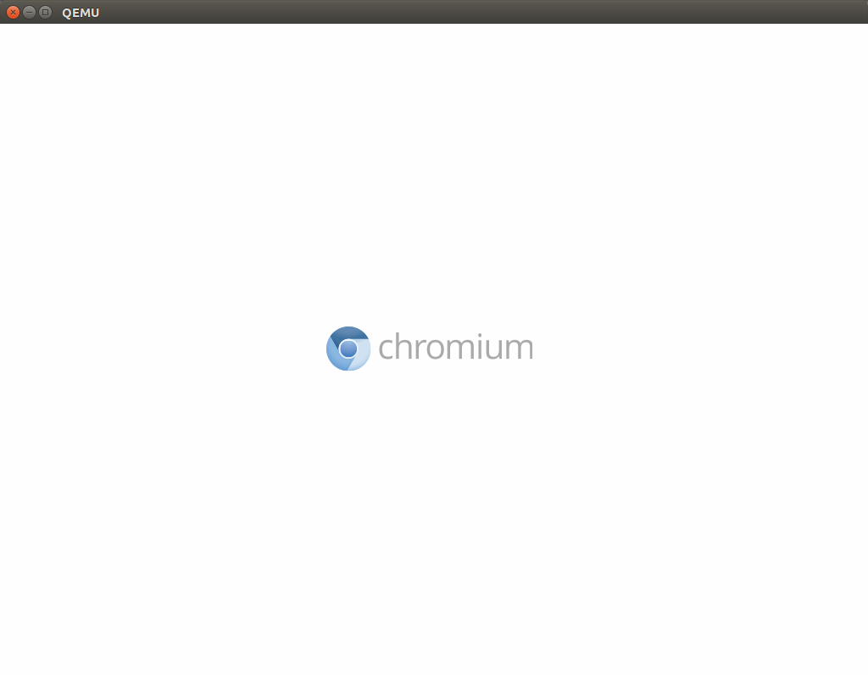
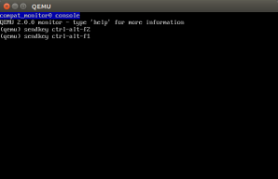
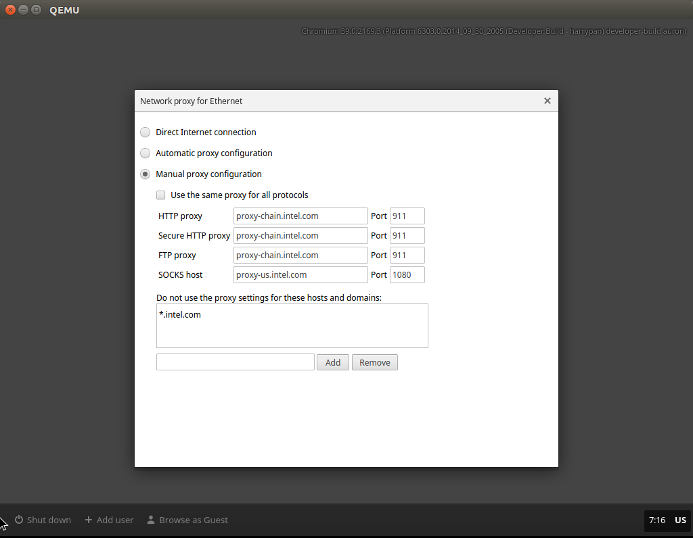
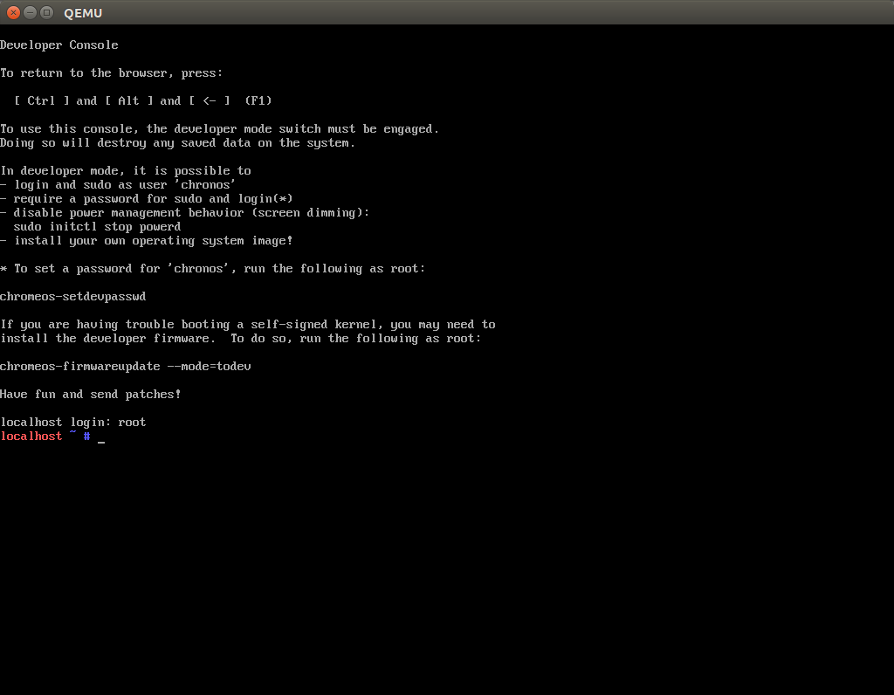
How to add private overlay for specific platform (2/2)
Test your images on QEMU (optional)
Assume you have QEMU at system-wide ($ sudo apt-get install qemu-kvm), and remember to turn on visualization in BIOS
Build image for QEMU (inside chroot)
(cr) $ ./image_to_vm.sh --from=../build/images/your_platform_name/latest --board=${BOARD}
Launch QEMU with image (outside chroot)
$ sudo kvm -m 2048 -hda src/build/images/auron/latest/chromiumos_qemu_image.bin -net nic,model=e1000 -net user
(cr) $ sudo qemu-system-x86_64 -enable-kvm -m 1024 -cpu Broadwell -net nic,model=e1000 -net user -hda /mnt/host/source/src/build/images/fox_wtm2/latest/chromiumos_qemu_image.bin
Note: Unlike system-wised QEMU, the one in cros_sdk uses VNC server, hence you need to get a VNC viewer, you could use VNC Viewer app

Slide 25
How to Configure Bluetooth Device ID
First identify the appropriate overlay for the board or variant, this is usually in
src/overlays/overlay-$BOARD but for devices still in development this may be in
src/private-overlays/overlay-$BOARD-private within the Chrome OS internal checkout.
The overlay should contain a "bsp" package, in chromeos-base/chromeos-bsp-$BOARD, with an
accompanying files directory. Do not mistake this for the "chromeos-bsp-$BOARD-private" overlay,
which does not generally have accompanying files.
Add a file called main.conf to the files directory containing the following:
[General]
DeviceID = bluetooth:00E0:XXXX:0400
Modify the ebuild file for the bsp package, adding to the src_install section:
# Install Bluetooth ID override.
insinto "/etc/bluetooth"
doins "${FILESDIR}/main.conf"
Don't forget to rename the ebuild symlink to increase the revision number.

Slide 26
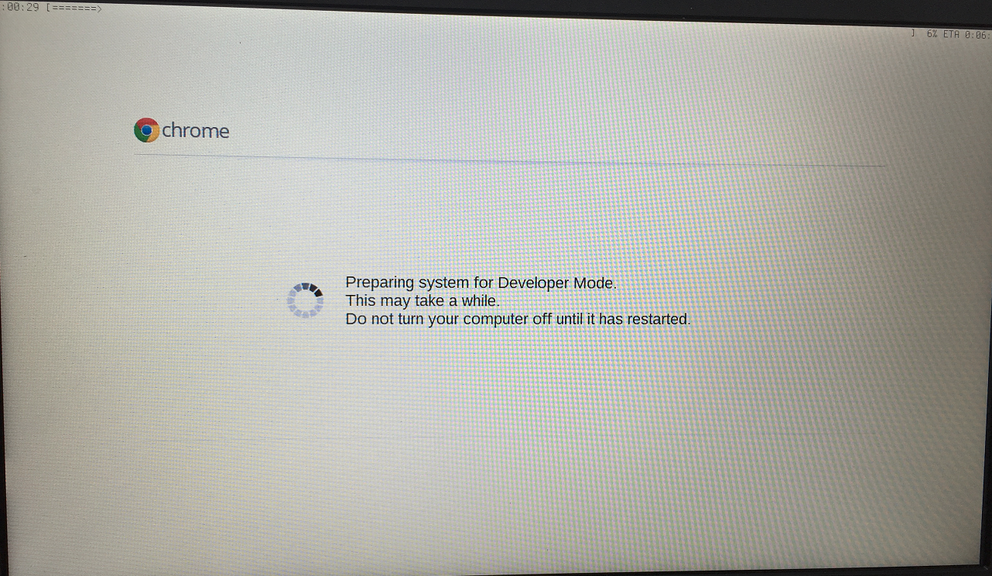
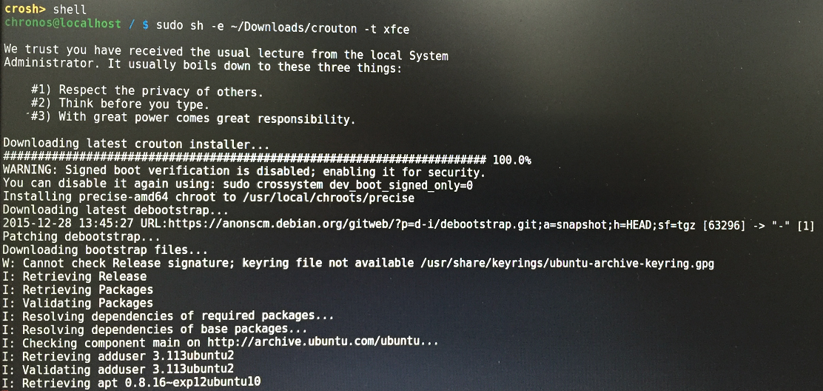
How to use Crouton to run Ubuntu inside Chromium OS
Step 1. Enabling Developer Mode
Step 2. Installing Crouton
Step 2.1 Download the latest release of Crouton to your Chromebook: http://goo.gl/fd3zc
Step 2.2 Install Crouton with the Xfce desktop
Step 3. Run Ubuntu - sudo startxfce4
Step 4. OS switch
Chrome OS -> Ubuntu : Alt+Ctrl+Shift+Back
Ubuntu -> Chrome OS : lt+Ctrl+Shift+Forward
Advanced installation:
sudo -i
cd /home/user/{uuid}/Download
List available target: sh ./crouton -t list
List available release: sh ./crouton -r list
Install Ubuntu 14.04 w/ Unity: sh ./crouton -t unity-desktop -r trusty
Install Xfce w/ applications: sh ./crouton -t xfce-desktop
Install LXDE w/ applications: sh ./crouton -t lxde-desktop
Install GNOME w/ applications: sh ./crouton -t gnome-desktop
Install KDE w/ applications: sh ./crouton -t kde-desktop

Slide 27
Crostini
Crostini should supplant Crouton that you can run Android and Linux applications side-by-side with the familiar web browser environment of Chromium OS.
Enable VT-x configuration in firmware
Enabling Crostini is simple, switch to the developers channel, then go into settings, scroll down to Linux (Beta), and enable it that causes a download of the Crostini/Linux support, and away you go.
For news about Crostini: https://www.reddit.com/r/Crostini/
Crostini Wiki: https://old.reddit.com/r/Crostini/wiki/index
Notes:
Reference:
https://techsparx.com/chromebooks/crostini/crostini-getting-started.html
https://www.reddit.com/r/Crostini/

